Slide 1


AUTONOMOUS
FOLLOW ME ROBOT
http://www.free-powerpoint-templates-design.com
PREPARED BY :- CHETANYA GAUR
AKSHAT BANSAL
JONNY BATHAM
KUNAL BATHAM

Slide 2
AUTONOMOUS ROBOT
A robot that performs tasks with a high degree of autonomy(without external influence).
Autonomous robotics is usually considered to be a subfield of artificial intelligence , robotics and information engineering

Slide 3
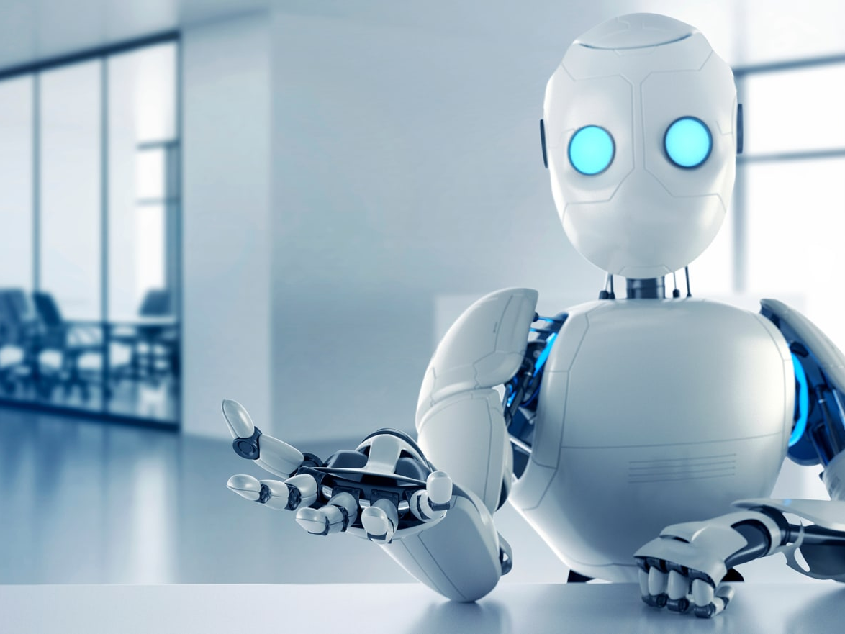
ALLPPT Layout
Clean Text Slide
for your Presentation
WHAT IS A FOLLOW ME ROBOT ?
ARTIFICIAL INTELLIGENCE
Modern Portfolio Presentation
ALLPPT.com

Slide 4

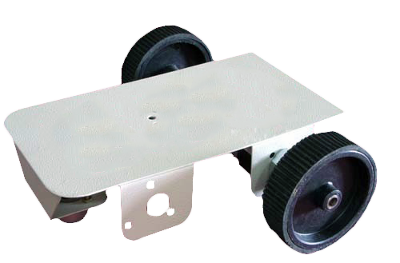

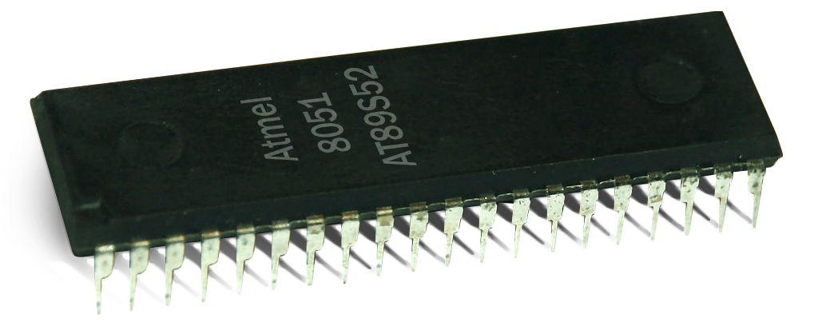
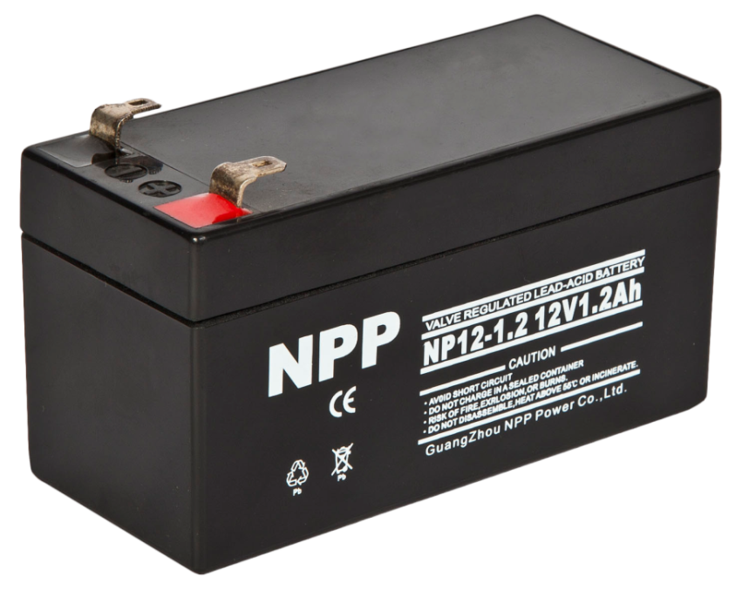
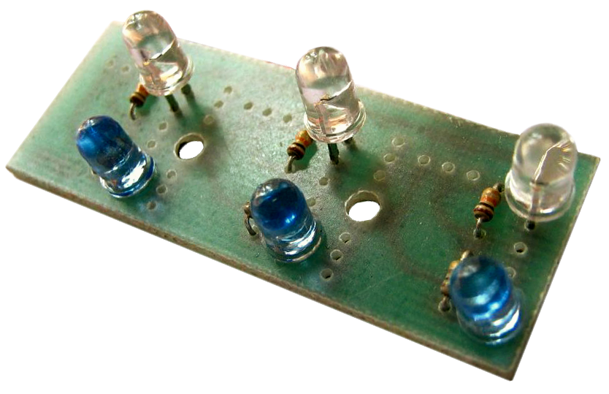
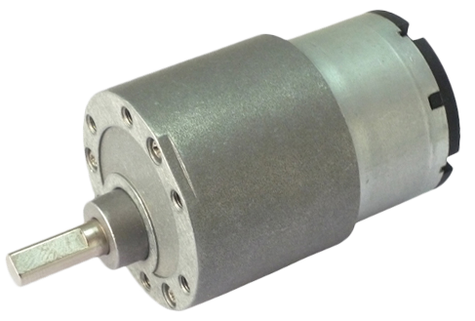
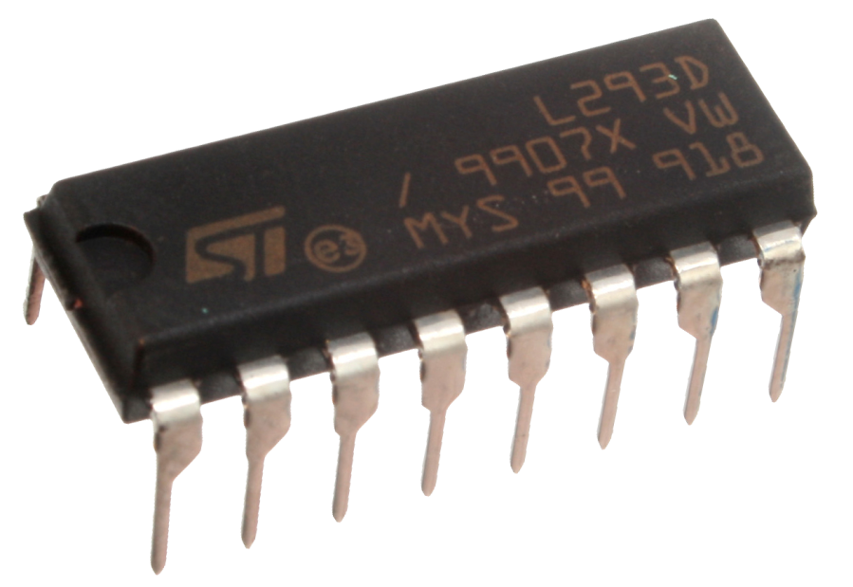
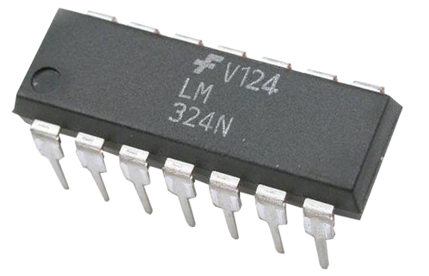
FOLLOW ME ROBOT
COMPONENTS USED
12V DC GEARED MOTOR
12V BATTERY
LM324 COMPARATOR
MICROCONTROLLER
IR TRANSMITTER RECEIVER PAIR
L293D MOTOR DRIVER
CHASSIS + WHEELS

Slide 5
HOW IR SENSORS WORKS
IR SENSORS

Slide 6

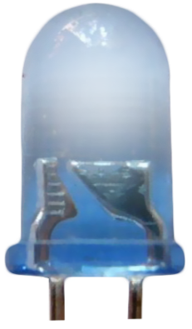
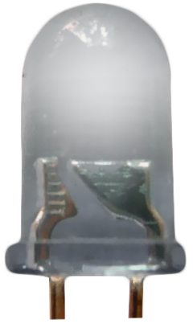


IR TRANSMITTER RECIEVER PAIR
TX
RX

Slide 7
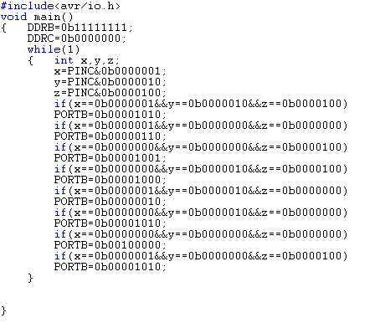
PROGRAMMING
3-SENSORS
(8 POSSIBILITIES)
STOP AND SOUND BUZZER

Slide 8
LOGIC OF FOLLOW ME ROBOT

Slide 9
FOLLOW ME ROBOT
Suitcase
1
2
Wheel chairs
Train
3
4
boats
APPLICATIONS
Missiles
5
6
carts
And many more……

Slide 10


SUITCASE FOLLOWING HIS OWNER
.

Slide 11
A TANK IS FOLLOWING A SOLDIER

Slide 12
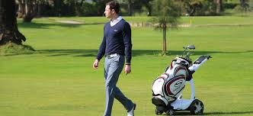
Worldmap Infographic
A GOLF KIT FOLLOWING HIS OWNER

Slide 13
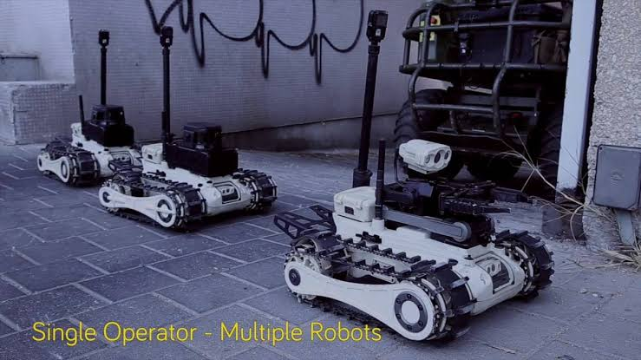
A ROBOT FOLLOWED BY A ROBOT FOLLOWED BY AN ANOTHER ROBOT

Slide 14
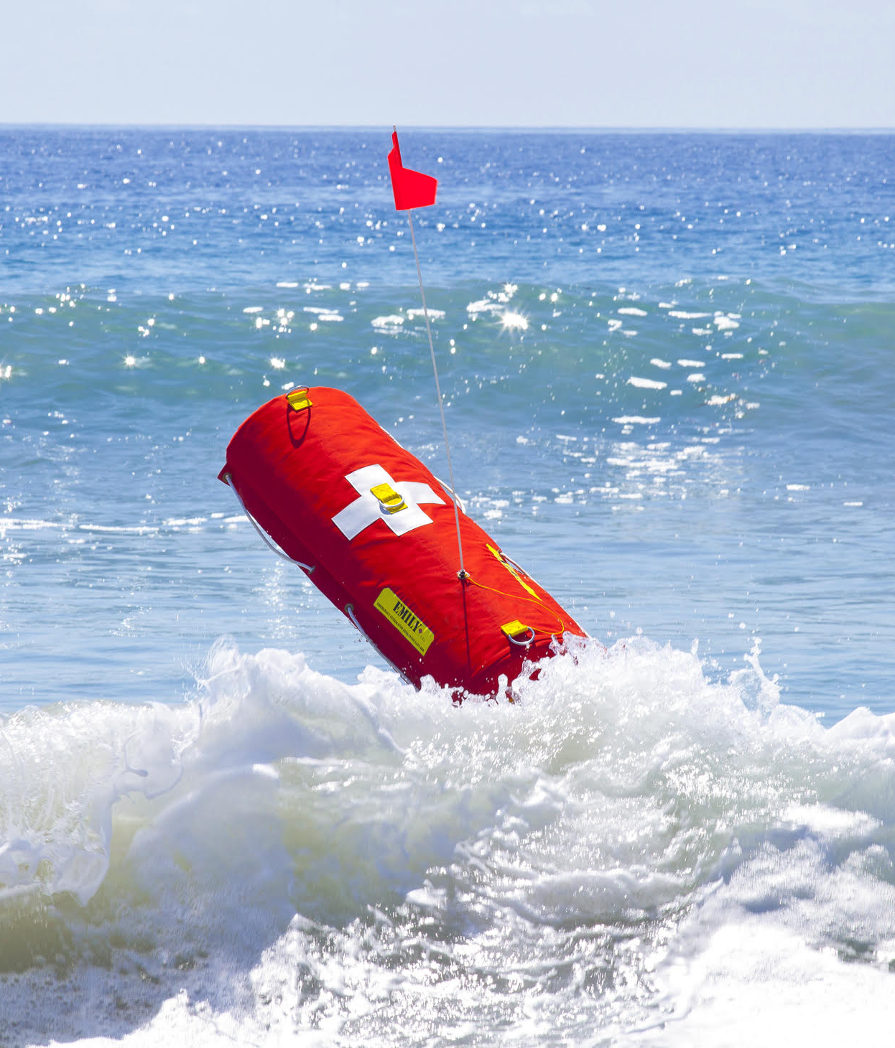
LIFE SAVING FOLLOW ME AIR BAG ROBOT

Slide 15
WHILE MAKING THIS PROJECT
DIFFICULTIES
SOLUTIONS
USING THREE SENSORS (WITH 8 POSSIBILITIES) INSTEAD OF 2 SENSORS
INCREASE ITS RANGE SO THAT IT WILL MOVE MORE ACCURATELY.
WHAT IF IT LEFT BEHIND.
THE IDEA OF BUZZER
TO MAKE IT FOLLOW WITH A CONSTANT DISTANCE(WITH 9 V BATTERIES)
BY TAKING MANY OBSERVATIONS ,WITH DIFFERENT POWER OF BATTERIES

